Slide 1
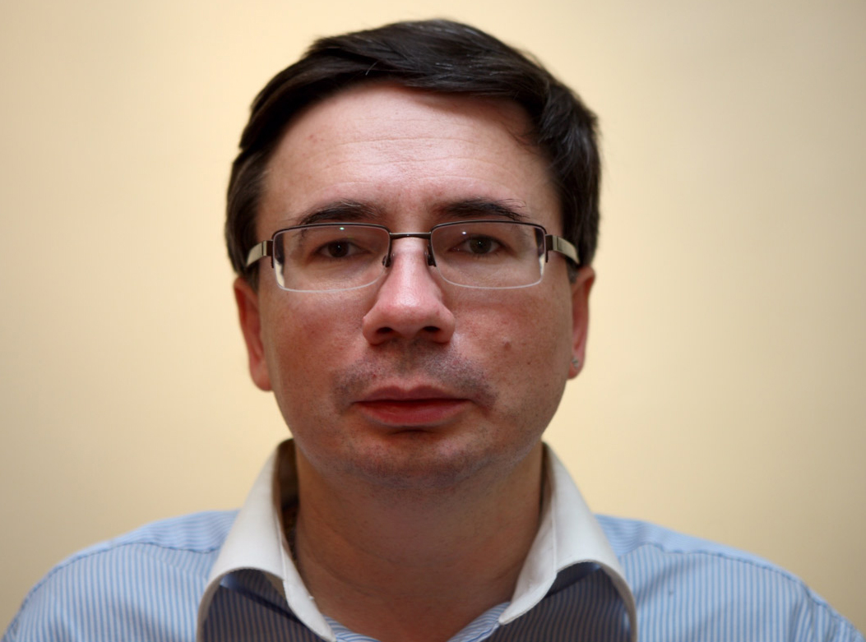
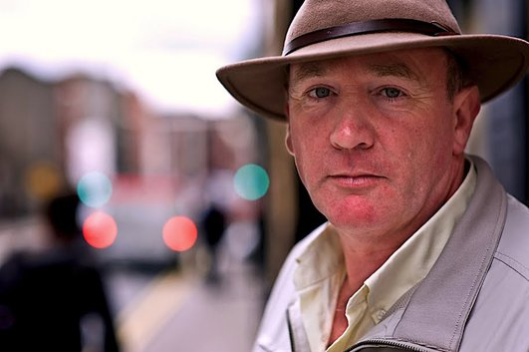
Science of ordinary things
Dr Edward G. Timoshenko
presented by Paddy O’Gorman on RTE.ie (C)
Computers | Detergents | Paints | Photography

